Slide 1

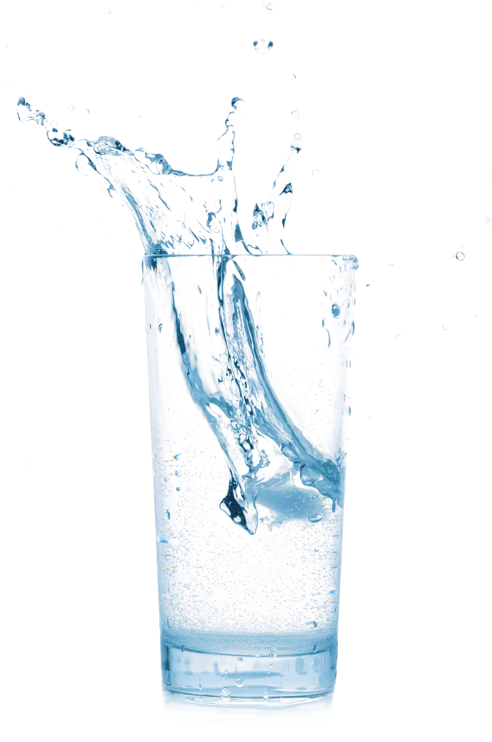
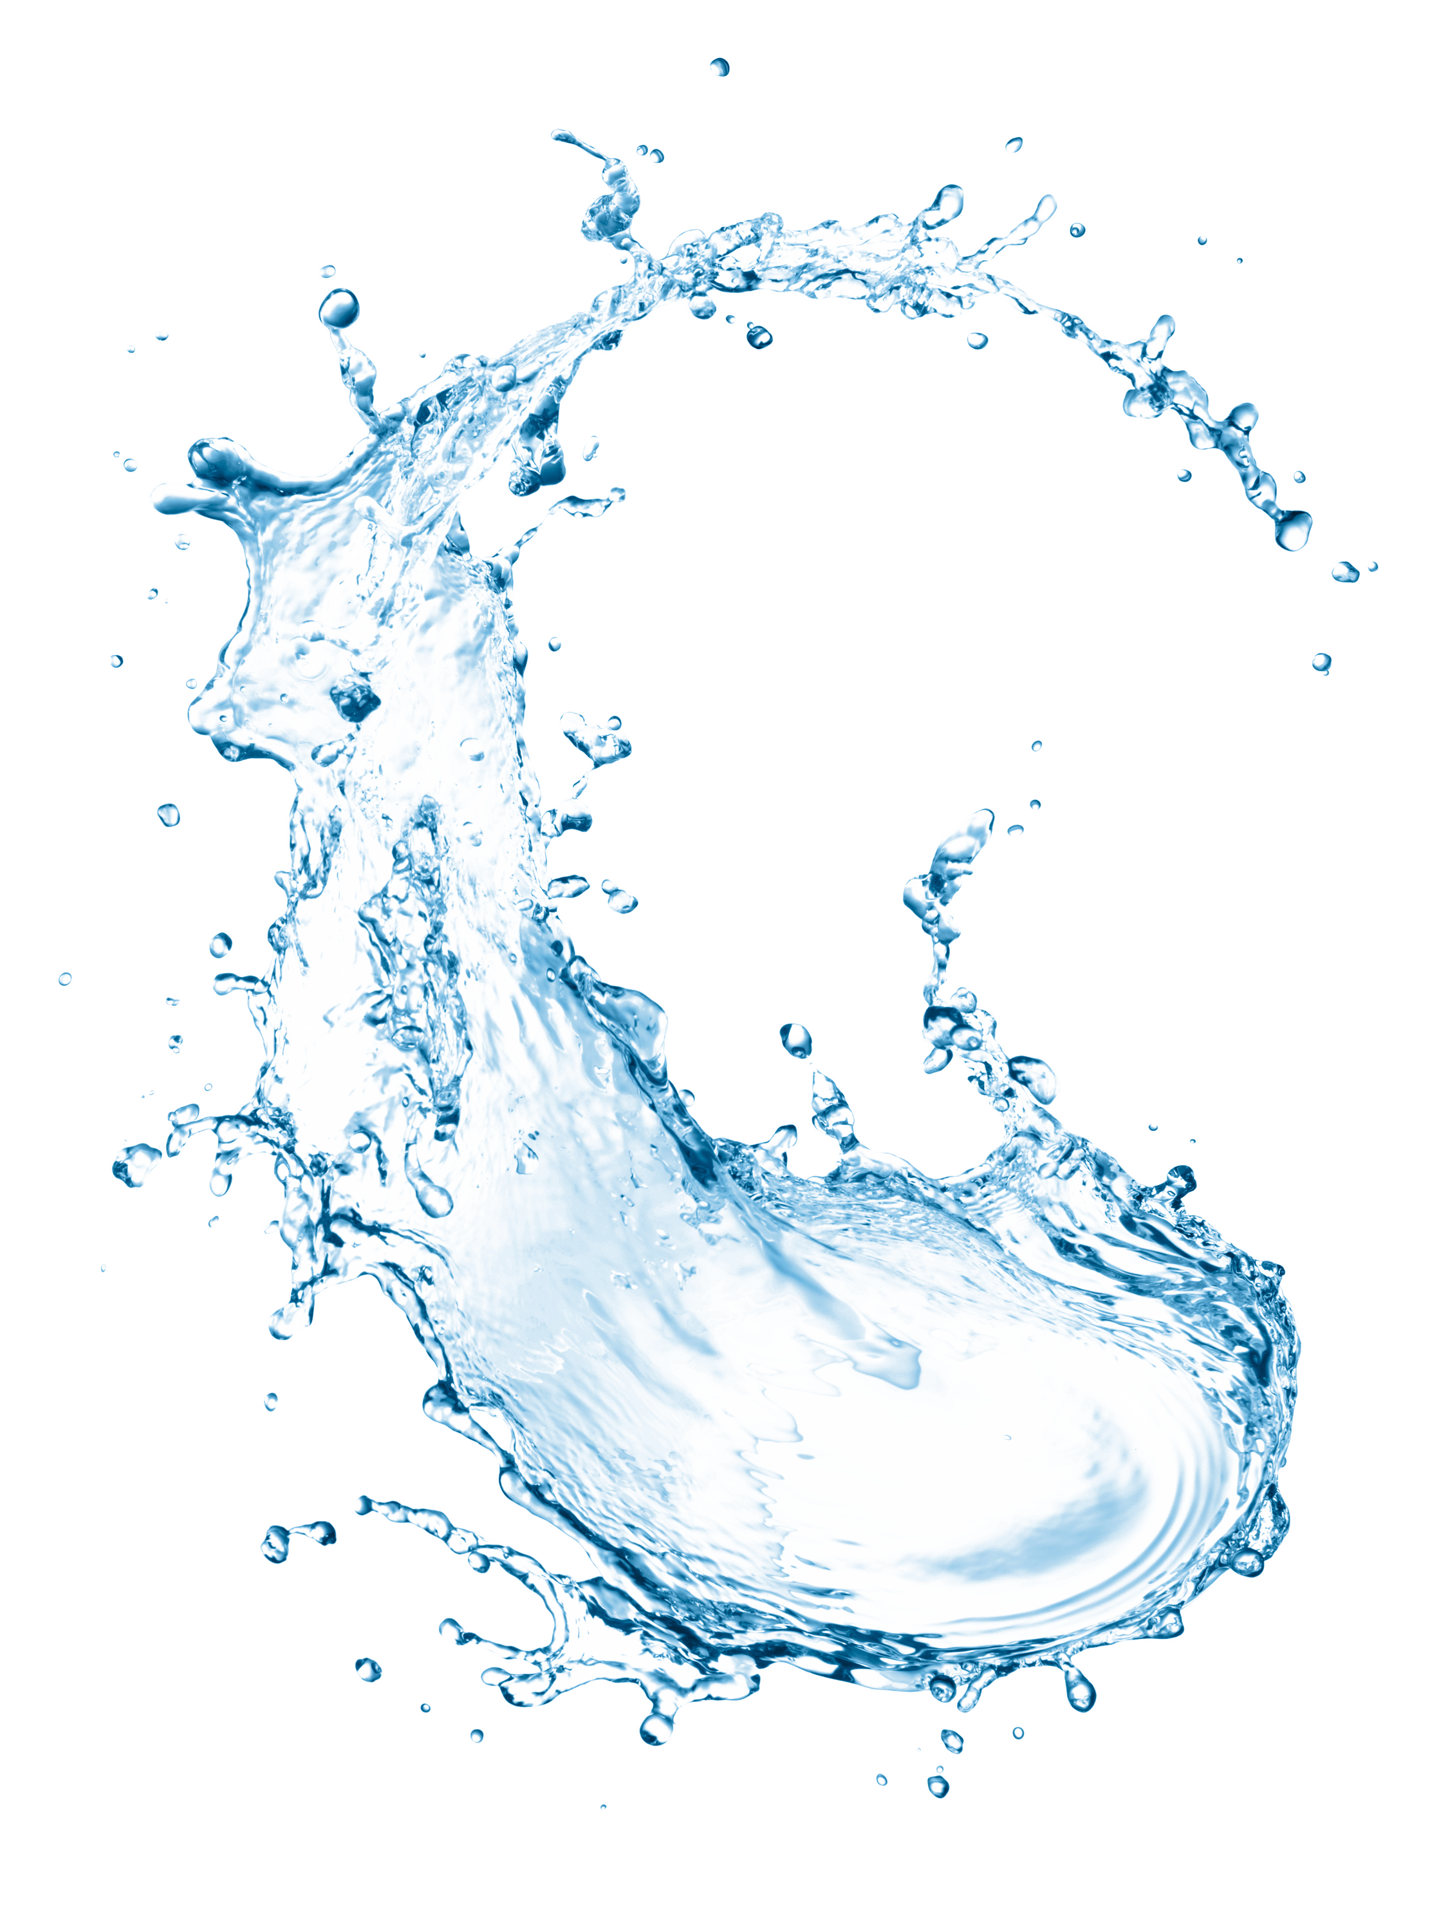


A CLASSIFICATION MODEL TO SMARTLY PREDICT WATER PUMPS FOR MAINTENANCE IN TANZANIA
Moses Thiongo

Slide 2
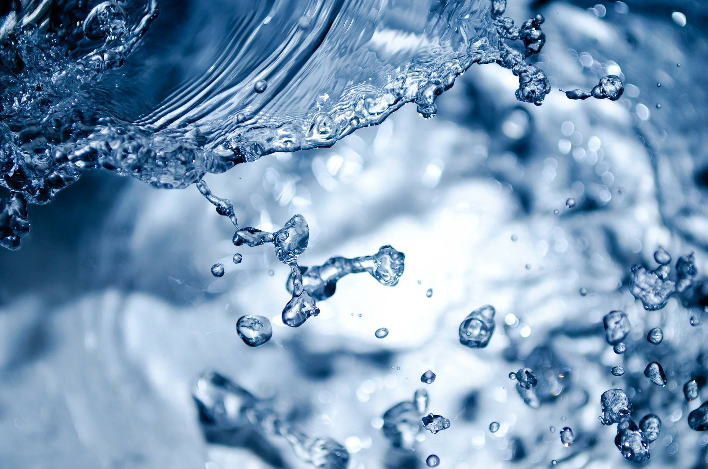
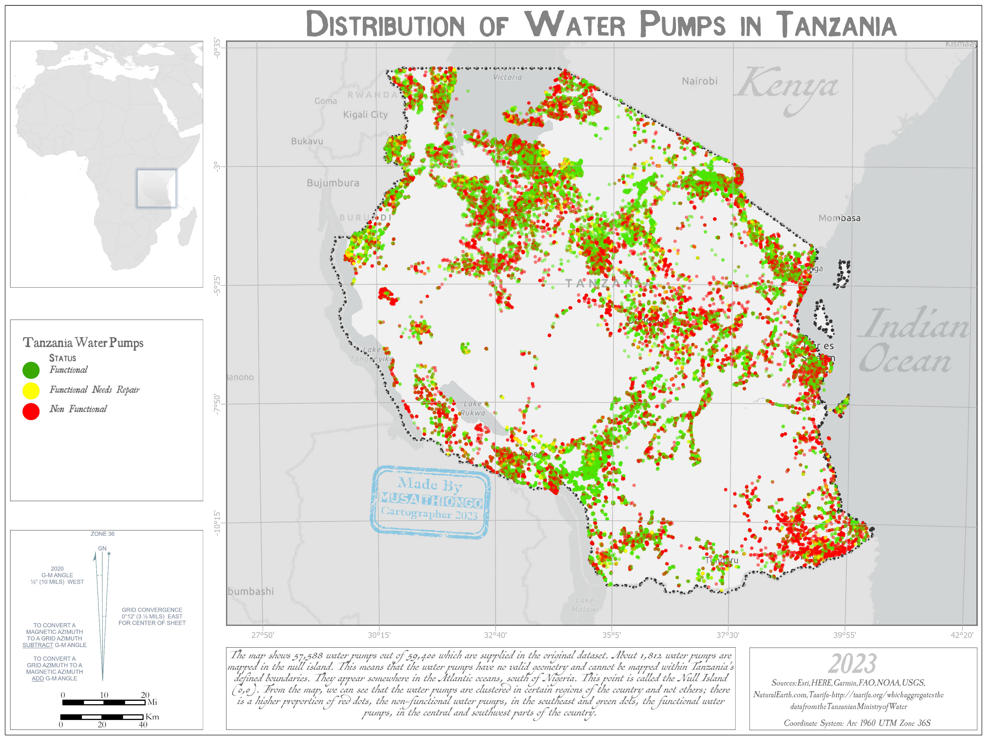
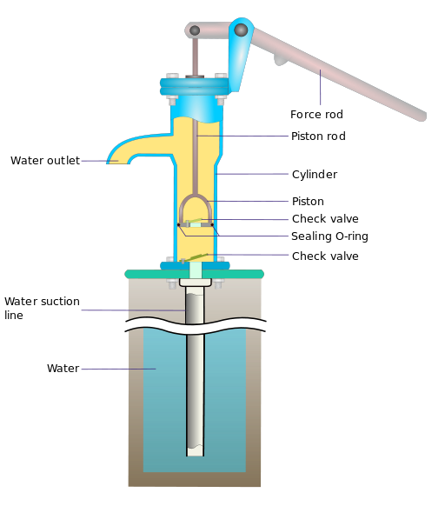
INTRODUCTION
A Model to predict which water pumps will need maintenance to ensure that clean, and potable water is available to communities across the United Republic of Tanzania.

Slide 3
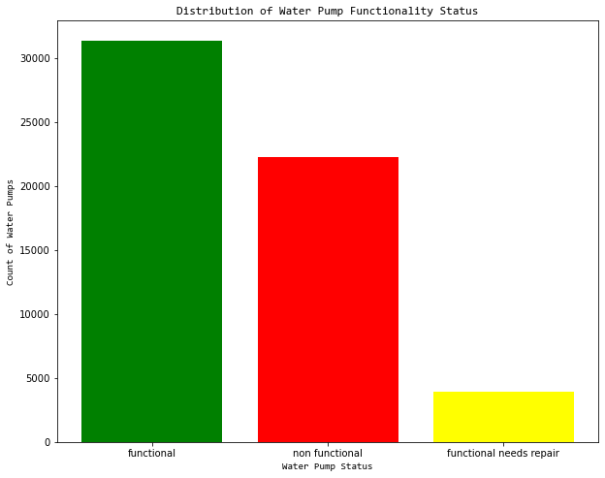
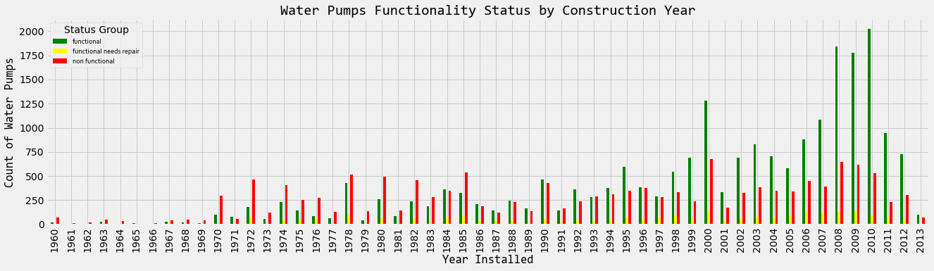
Generally, there are many water pumps that are functional compared to the others. However, there is a high % of water pumps that are nonfunctional.
DATA
The Data is download from the Driven Data site and has been attributed to the Taarifa which aggregates the data from the Tanzanian Ministry of Water.

Slide 4
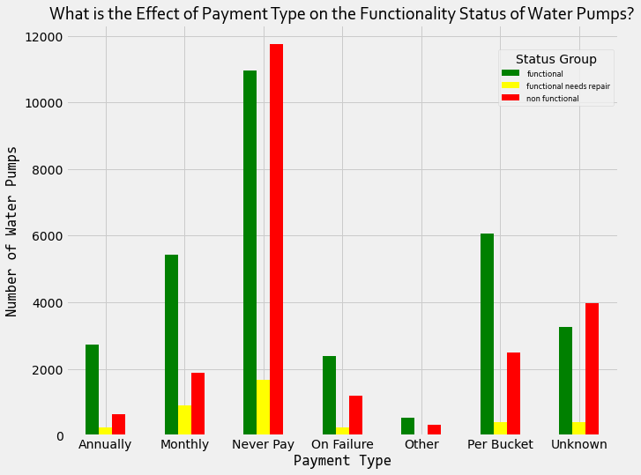
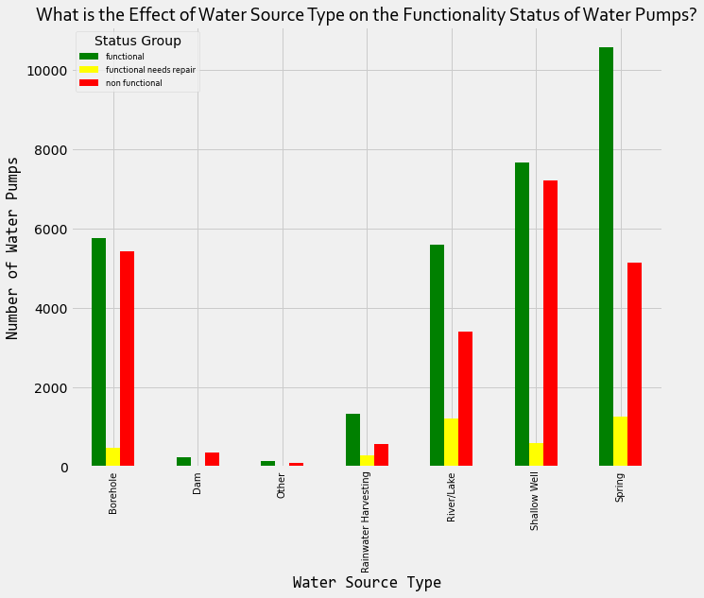
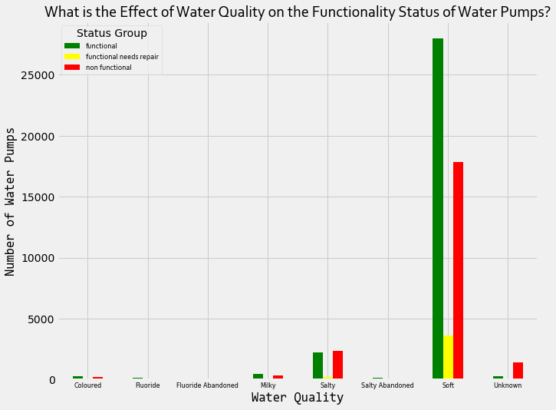
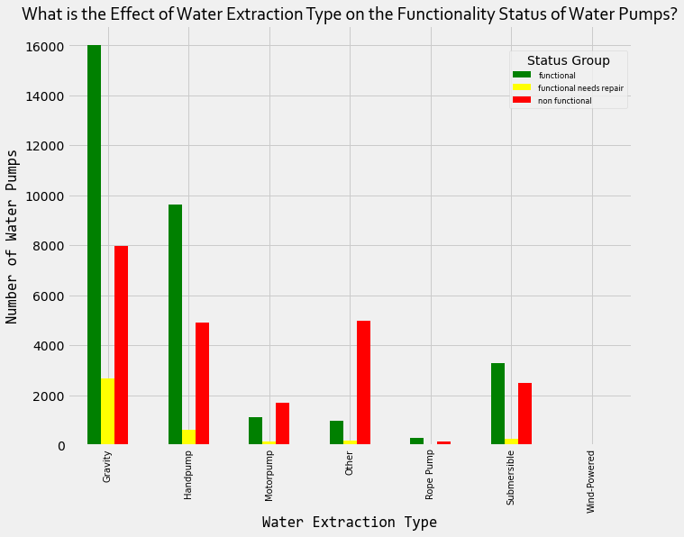
The Payment Type with Never Pay has the highest of the three status groups. c
Water Source Type that comes from the spring has the highest number of functional water pumps. Shallow wells has the highest of nonfunctional water pumps.
Soft water has the highest number of water pumps that are functional, functional needs repair and nonfunctional
Water Extraction type with the highest functional and nonfunctional water pumps is Gravity followed by handpump.

Slide 5
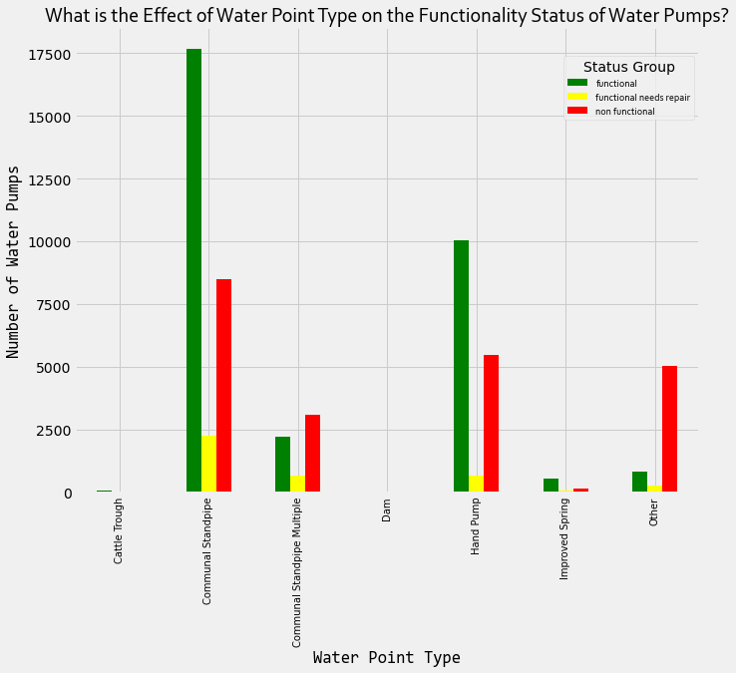
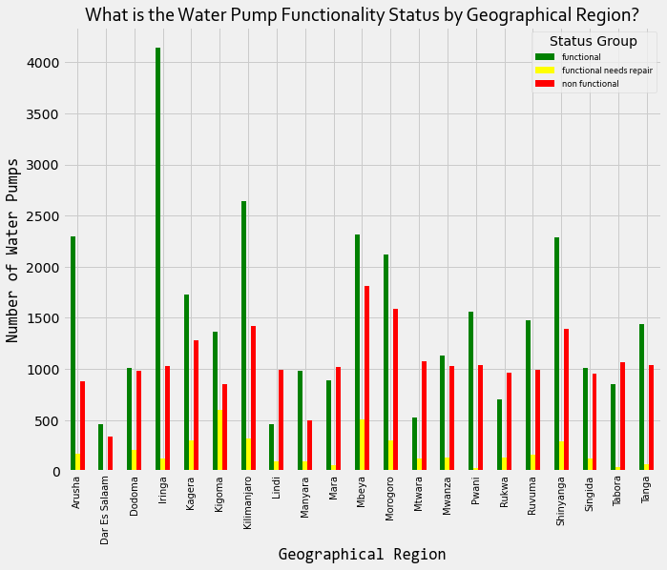
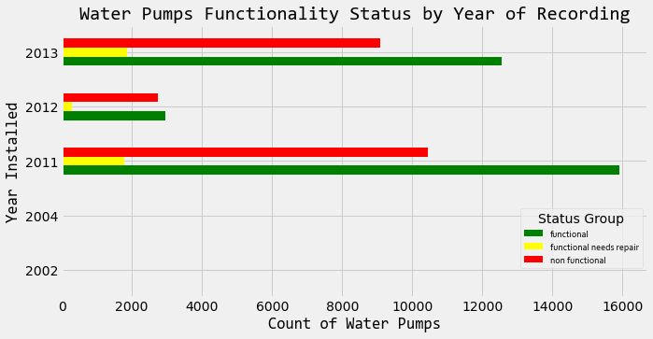

Slide 6
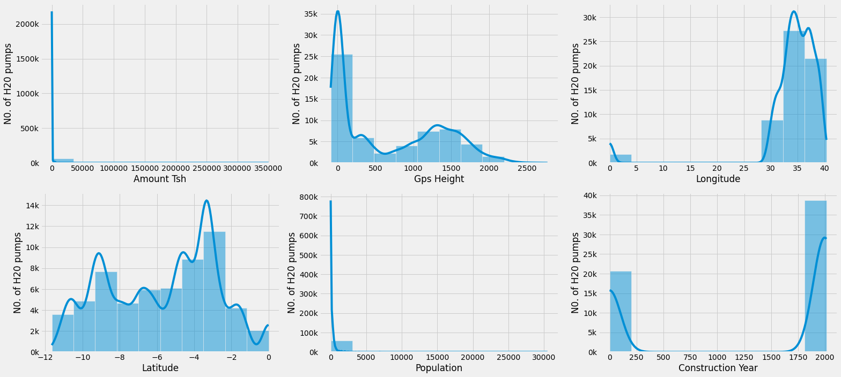
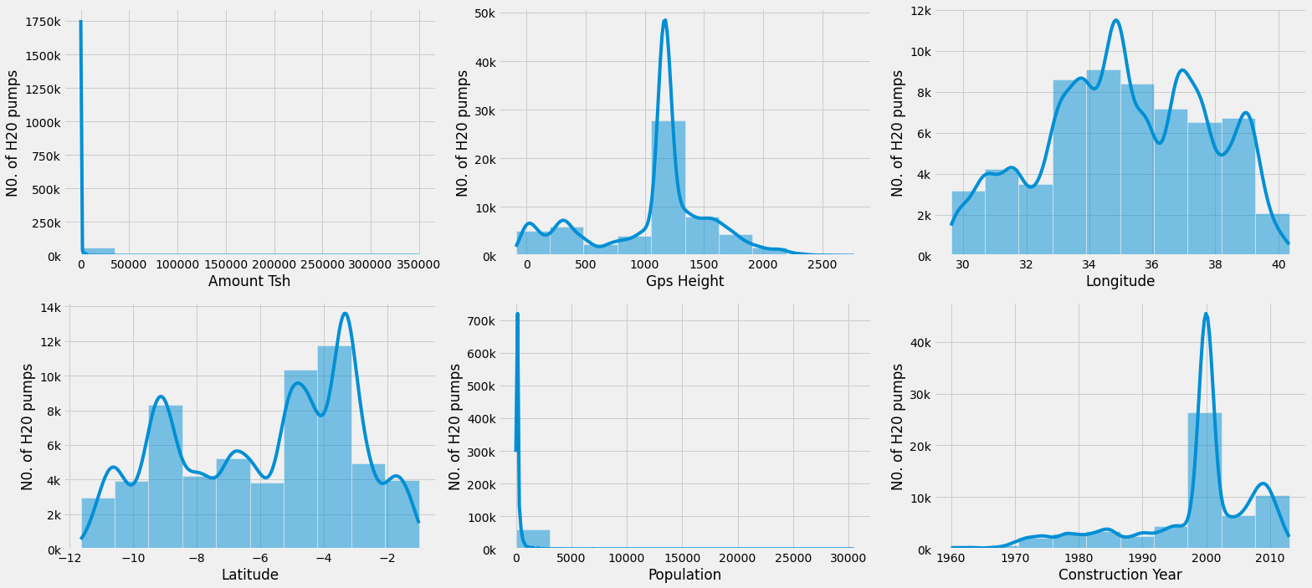
OUTLIERS
Outliers are examined and dealt with in our classification model. The column placeholders were also carefully taken care of.
The Longitude and Latitude column that had 0,0 were removed to avoid those entry records which could not be properly mapped in Tanzania.

Slide 7
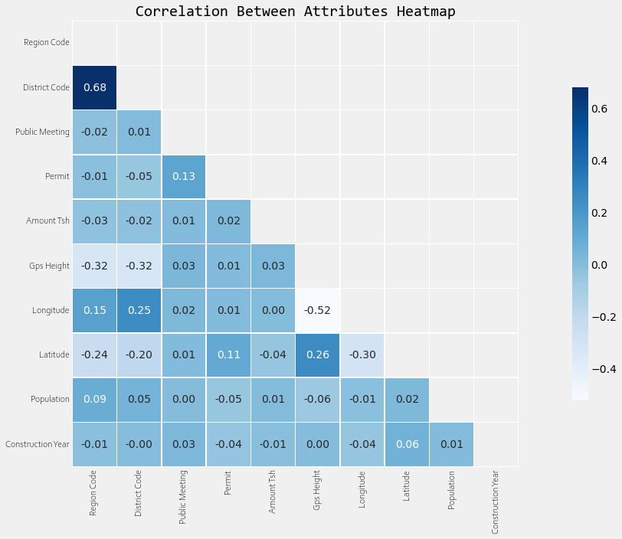
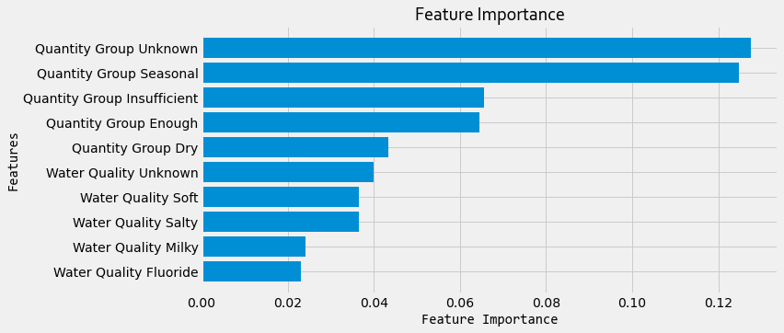
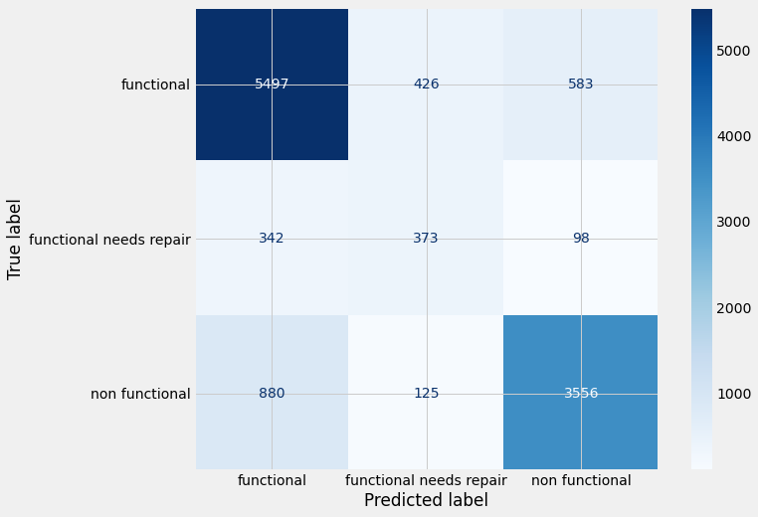
MODELING
As examined, the features there was no high multicollinearity between attributes of our Tanzania Water Pumps Dataset

Slide 8
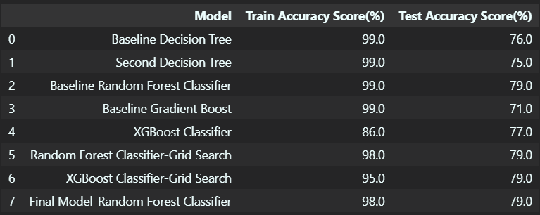
The Model Finally Achieved an Accuracy Prediction of 79.41%

Slide 9
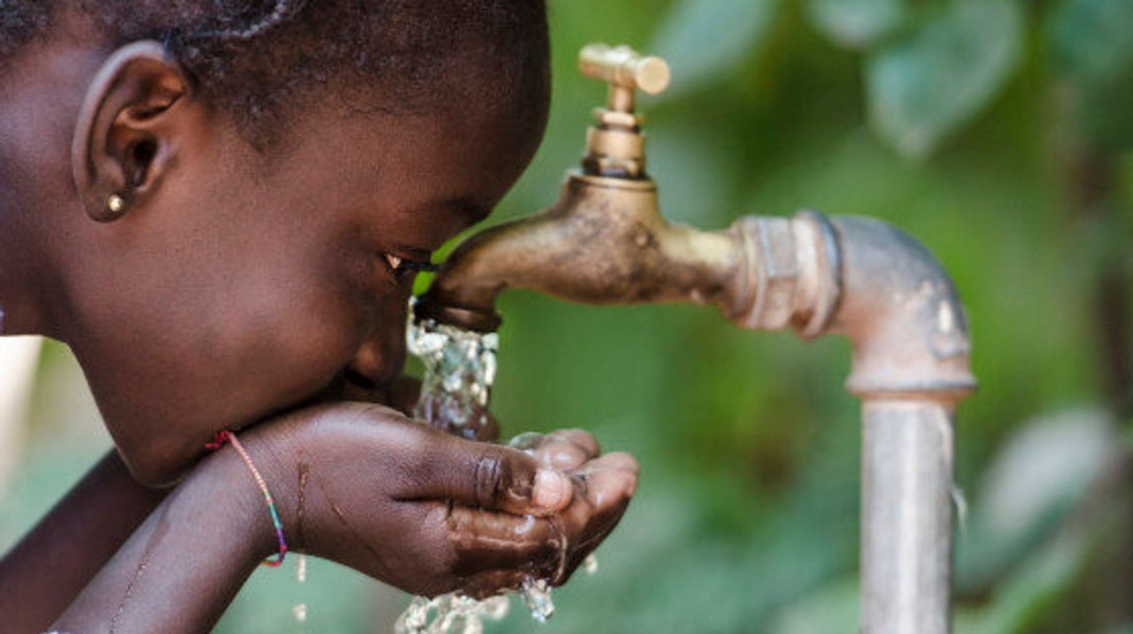
CHALLENGES
The data had a lot of gaps that were either not filled or got filled but in a very general way.
For such dataset, there were a high number (about 3%) of the water pumps that had not been mapped in Tanzania. This brought a challenge in determining where they were spatially supposed to be located. If this results are to be relied upon, such water pumps are supposed to accurately located.

Slide 10

RECOMMENDATIONS
When gathering the data, it is important to use, among other reliable instruments, a high precision GPs. This would help the technical team visiting the water pump have an easy time getting their way around.
Data cleaning and verification while in the field would be so crucial to ensure that valid results are taken back to the office for analysis.
The government or the responsible agencies (e.g., the Ministry of Water) should put up a task force that ensures periodic data update to stay up-to-date with the requirements of all the water pumps and the type of care they need.
The data collection should be focused more on the nonfunctional water pumps.
A research to understand what mainly caused breakage.

Slide 11
END
GitHub Repository

